Slide 1
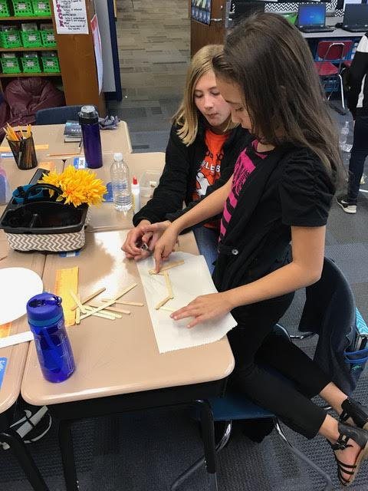
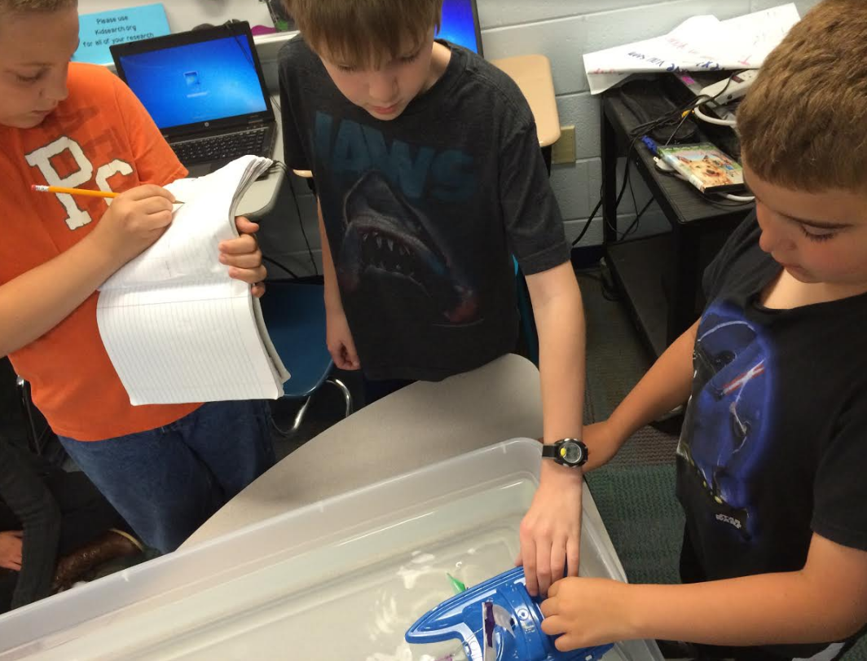
Lifeguard Chair
JAMES MINOGUE
ARIELLE MUCHA
JESSICA SCHENKEL
This material is based upon work supported by the National Science Foundation under Grant No. 0962840
.

Slide 2
Problem Solving – Escalator Problem

Slide 3
HOW WILL SLED BENEFIT YOUR CLASS?
Aligns with content and process standards
Problem solving
Collaboration
Communication
Team work
Growth and engineering mindset
Gives purpose for learning
Developing better understanding of math concepts
Engaging, hands-on activities
Cross-curricular connections

Slide 4
Engineers
Engineers find problems in the world and design solutions
Engineers are responsible for designing many different things in the human-made world.
Engineers are also responsible for designing the less obvious products.
How about chairs?

Slide 5
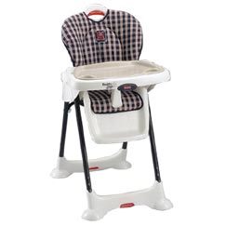
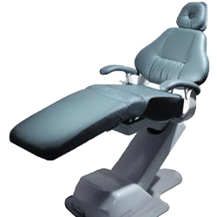
Chairs
Think about a baby’s high chair vs. a chair in a doctor’s office.
Think: What factors must engineers consider as they design chairs?

Slide 6
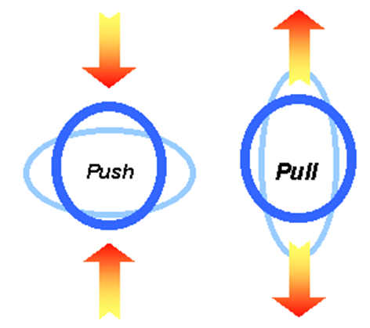
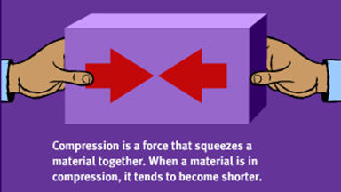
Forces acting on a chair
Compression vs. Tension
Notes:
Gravity as downward force and upward force of Earth. When balance, the chair remains still.
Adding weight adds other force considerations
http://www.pbs.org/wgbh/buildingbig/lab/forces.html

Slide 7
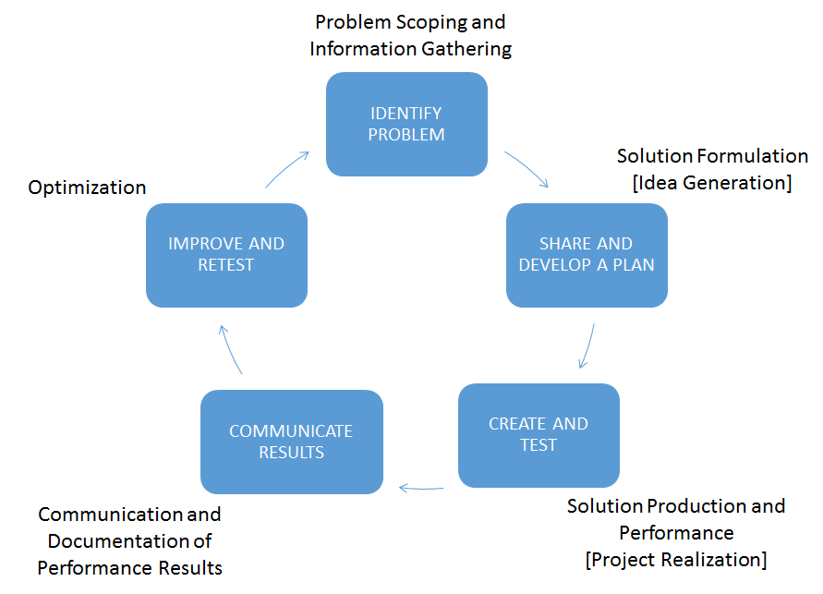
THE ENGINEERING DESIGN PROCESS

Slide 8
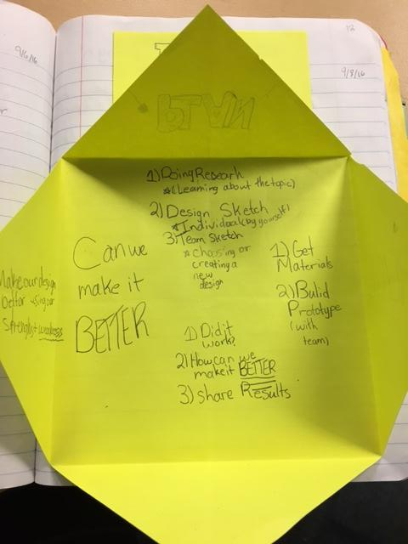
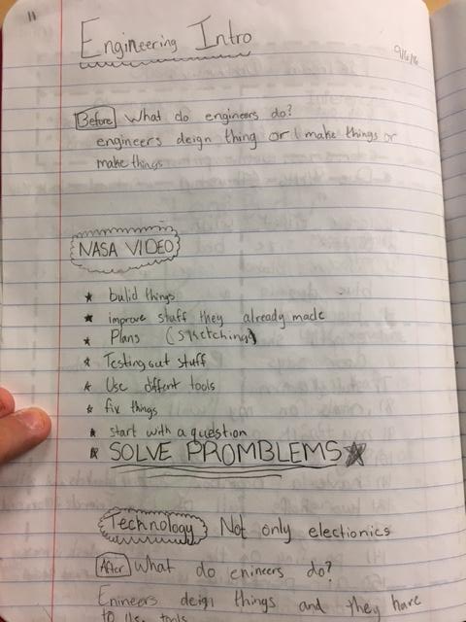
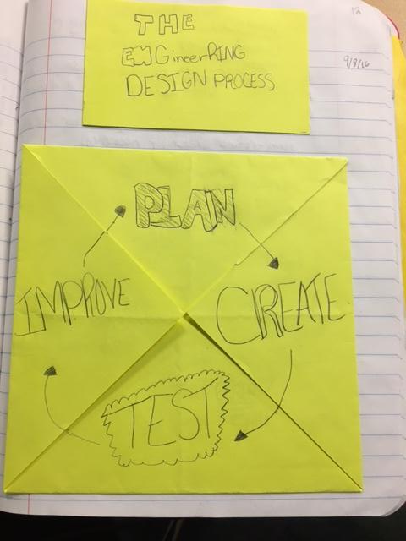
INTRO TO THE DESIGN PROCESS

Slide 9
THE ENGINEERING DESIGN PROCESS

Slide 10
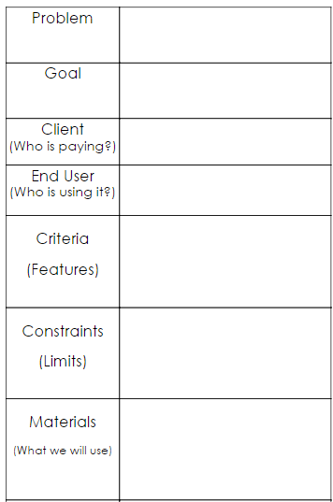
INTRODUCING THE TASK - DESIGN BRIEF
TIME: Shortest amount of class time (15 - 20 minutes)
As students become more familiar with engineering
design process vocabulary, takes even less time.
KEY TERMS:
Problem
Goal
Client
End user
Criteria (desired features)
Constraints (limitations)
Materials

Slide 11
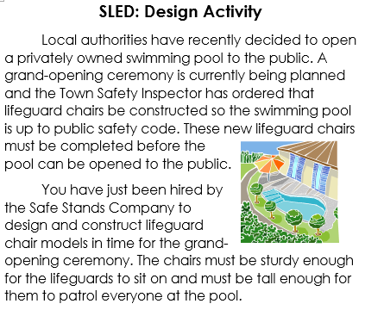
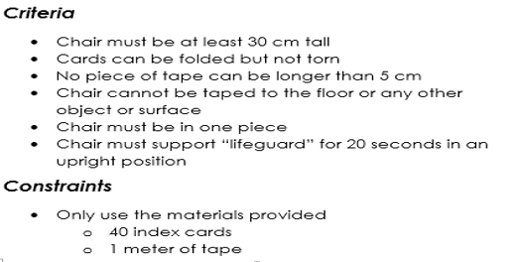
INTRO – DESIGN TASK

Slide 12
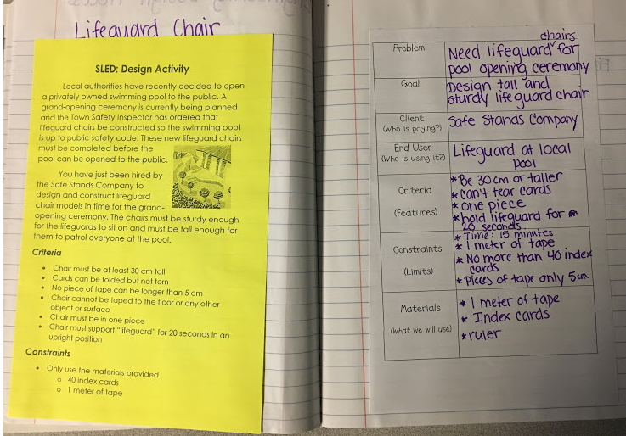
DESIGN BRIEF TEMPLATE – LIFEGUARD CHAIR

Slide 13
THE ENGINEERING DESIGN PROCESS

Slide 14
INDIVIDUAL DESIGN
TIME: 15-20 minutes
DESIGN SKETCH FEATURES:
Pencil/paper (or other appropriate medium)
Materials used
Makes good use of space
Labels/key
Multiple views
Measurements or cost, if applicable
Key science content terms

Slide 15
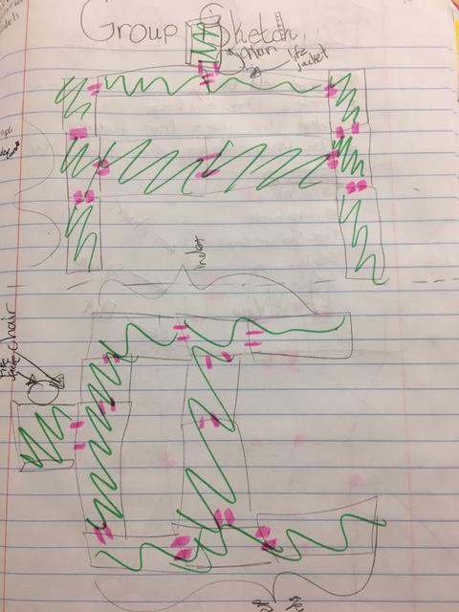
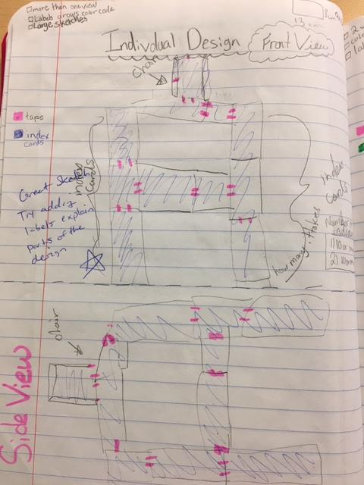
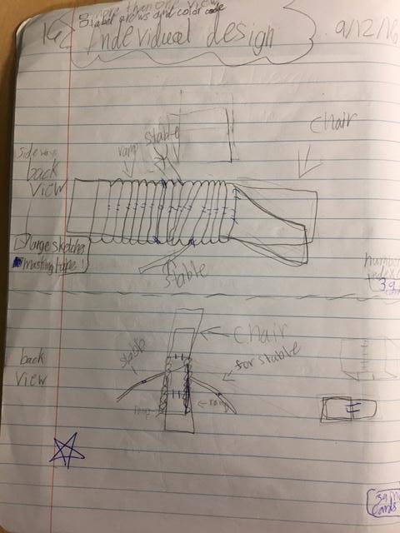
GROUP/INDIVIDUAL DESIGN - EXAMPLES

Slide 16
Questions to Consider
What are examples of chairs that come to mind?
Tables and chairs have supports to keep their legs from tilting or twisting. Look at the furniture in this room. How would you describe the supports you see?
What kinds of forces act on a chair or table?
How will these forces play a role in your design?
What can you do to prevent your chair from:
–Tilting and twisting
–Wobbling
–Collapsing

Slide 17
YOUR TURN! - INDIVIDUAL DESIGN
Materials
Up to 40 Index Cards
1 meter tape
REMEMBER…
Make good use of space
Labels/key - include total number of cards required for your design
Multiple views
You have 5 minutes!

Slide 18
GROUP/TEAM DESIGN
TIME: 20 - 30 MINUTES
***DESIGN SKETCH FEATURES FROM INDIVIDUAL DESIGN APPLY.***
GROUP DESIGN EXPECTATIONS:
Ideal groups of 2-3
Everyone shares ideas/design sketches.
Group consensus (combination, one student’s design, completely new design, etc. - Up to you!)
Each student sketches group design in individual notebooks. (Ensures understanding)
Turn to next blank page and write “Team Design” at the top.

Slide 19
YOUR TURN! - GROUP DESIGN
REMEMBER…
Groups of 2-3
Everyone should share ideas/design sketches
Group consensus
Each person should sketches group design in individual notebook
You have 7 minutes!

Slide 20
THE ENGINEERING DESIGN PROCESS

Slide 21
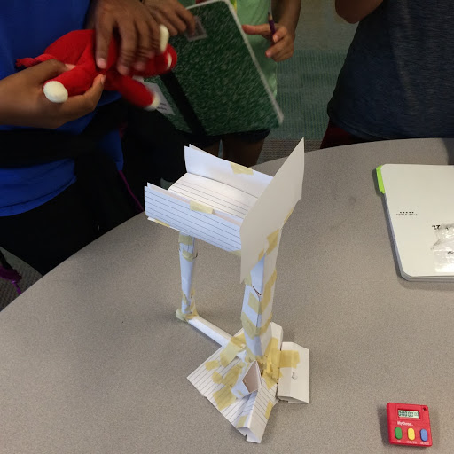
BUILD/CREATE - TEST
TIME: 30 minutes (varies by task)
TEAM BUILD & TEST:
Complete group designs before receiving materials. (Should build design as drawn)
Record any changes/adjustments as problems/ideas arise. (Depending on design task)
Depending on task - students test along the way or altogether as initial designs are completed

Slide 22
YOUR TURN! - GROUP BUILD/TEST!
REMEMBER…
Try to stick to your group design!
If you adjust record it on your design sketch!
Test you design and see if it meets the criteria!
Record results on data chart.
Was your team successful?
You have 15 minutes!

Slide 23
THE ENGINEERING DESIGN PROCESS

Slide 24
COMMUNICATE RESULTS
TIME: Throughout design process- (depending on task)
DATA AND OBSERVATIONS -
Document/discuss with group
Can include data tables, test summaries, etc.
STRENGTHS/WEAKNESSES -
Focus on utilizing weakness to inform redesign
Come together as class, making connections to experiences of others - using content specific vocabulary

Slide 25
Lifeguard Chair Testing
Group | Number of Cards Used | Seat Height (cm) | Time (s) | Met Criteria?
1
2
3
4
5
6
7
8
9
10

Slide 26
THE ENGINEERING DESIGN PROCESS

Slide 27
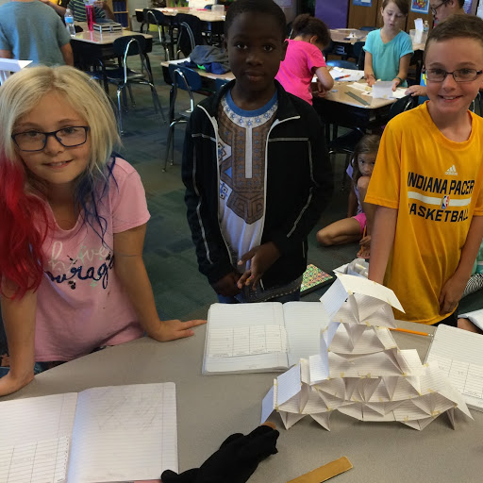
IMPROVE AND REDESIGN
TIME: Varies depending on task and time constraints - unlimited in nature
Individual and/or group redesign
Group rebuild and testing
REDESIGN
Teams conference and re-sketch their team design with improvements.
-In what ways could you improve your design?
-What is one feature you could re-design?
-To what extent could your redesign improve your results?
Even successful teams can make improvements
REFLECTION
Note improvements
Strengths/weaknesses
Additional redesign
Reflection on whole experience

Slide 28
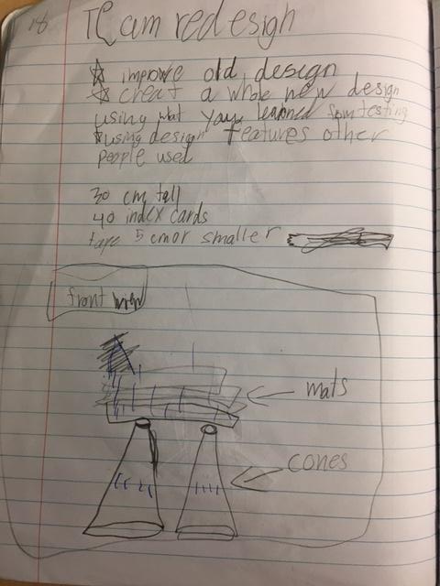
IMPROVE/REDESIGN

Slide 29
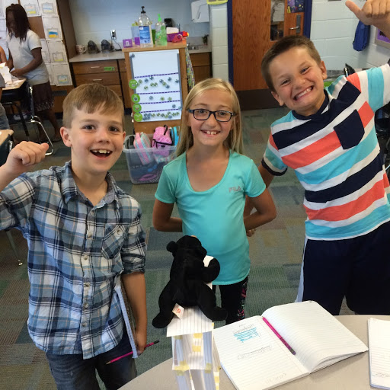
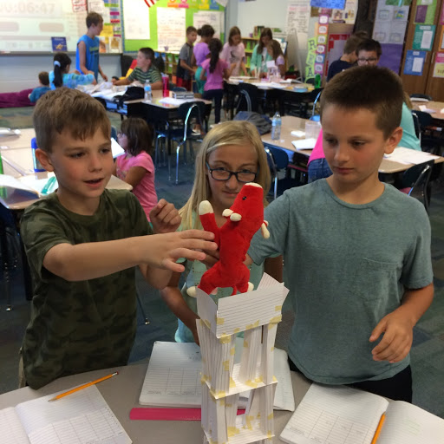

Slide 30
Evidence of student learning
Design notebook entries
Student use of science content vocabulary (when working with team or communicating results)
Pre/post assessment results (SLED)
Self/team rubric
Short video clip of a student talking aloud about their ideas.

Slide 31
Cross-curricular Connections
Math Connections
Budgeting
Measurement during design and testing (mass/ volume/ length)
Calculations of change during testing
Social Studies Connections
Geography
Environmental concerns
Community awareness (using local sites for design tasks)
Literacy Connections
Reflections and written response
Advertisement (persuasive writing & figurative language)
Trade books (informational text & fiction)
Famous inventor/field expert biography writing

