Slide 1
Simple Machines

Slide 2
Work
Using force to move an object

Slide 3
force
Push or pull

Slide 4
forces
gravity
friction
Force that pulls two
objects together
Gravity pulls us
toward the ground
Force that
holds back the
movement
of an object

Slide 5
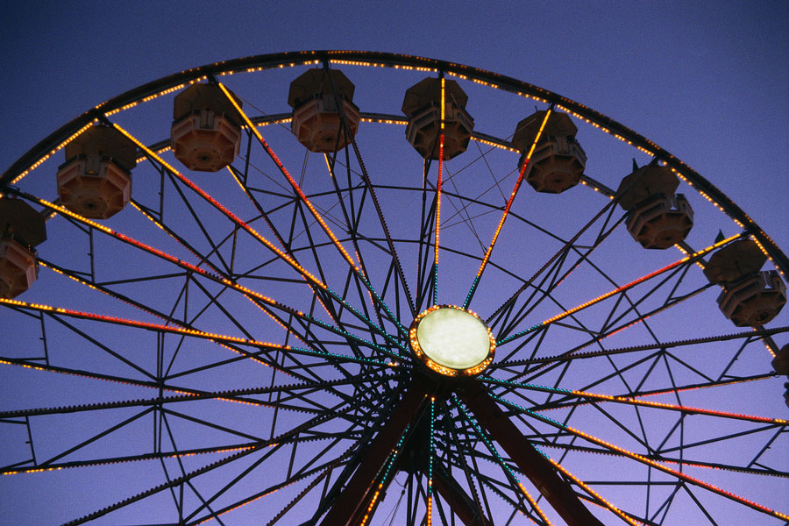
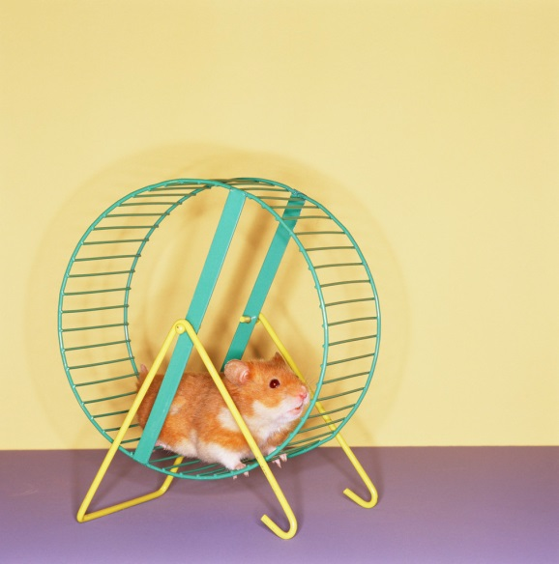
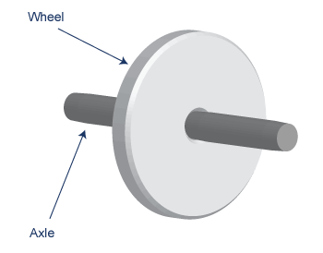
Wheel and Axle
connected so they
turn together

Slide 6

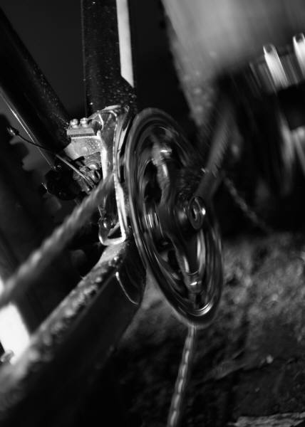
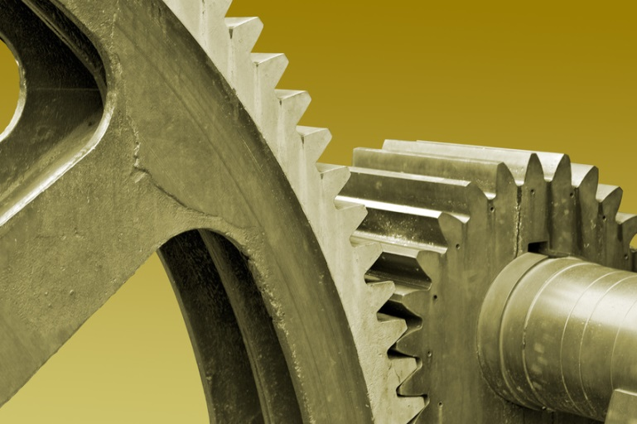
gears
Toothed wheels

Slide 7
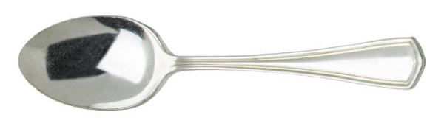
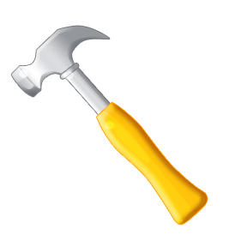
lever
fulcrum
a bar that pivots on a fixed point
the point that a lever pivots on

Slide 8
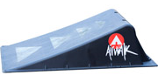
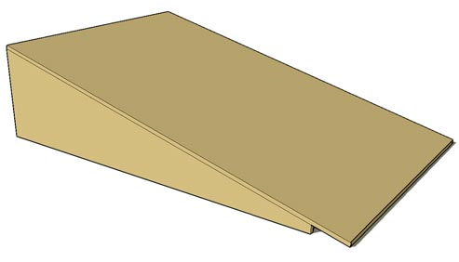
Inclined plane
flat, sloping surface

Slide 9
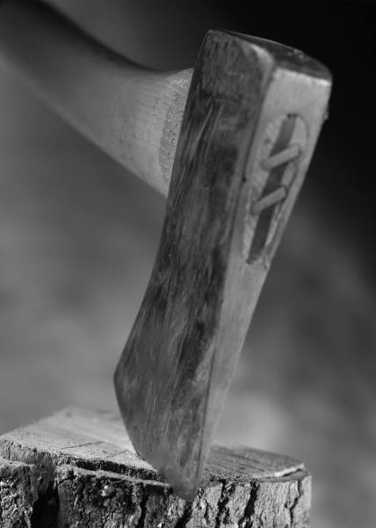

wedge
2 inclined planes placed back to back.
Used to force two things apart or split one thing into two.

Slide 10
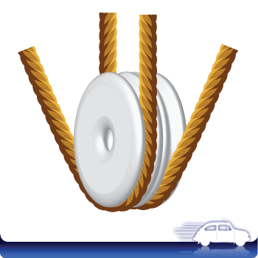
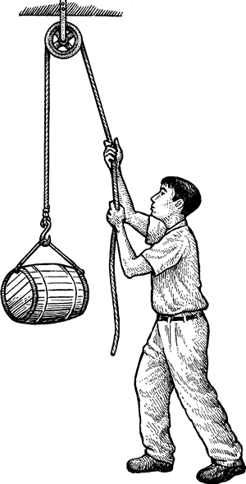
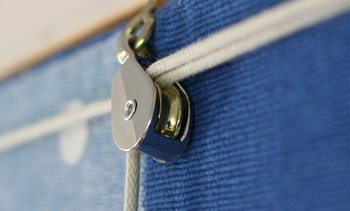
pulley
a wheel with a rope, cord, or chain around it
Makes work easier by changing the direction of force

Slide 11
Simple machines
few or no moving parts
used by applying force
make work easier by changing the amount of force needed to do the work

