Slide 1
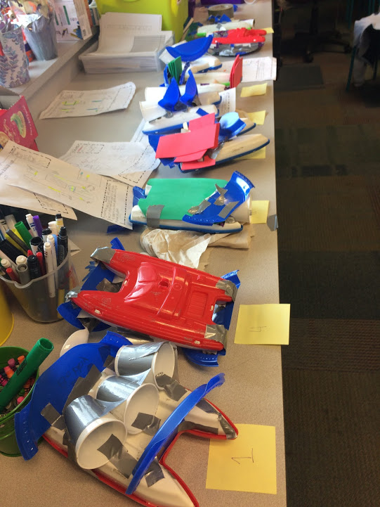
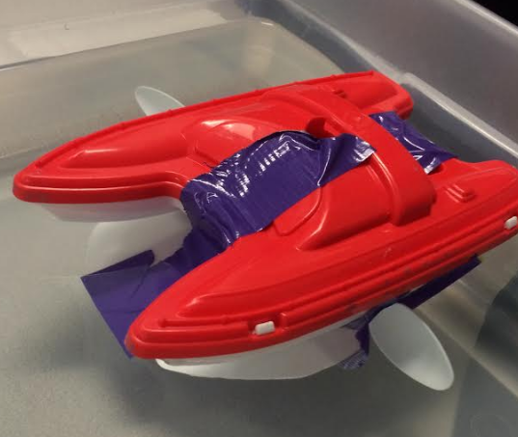
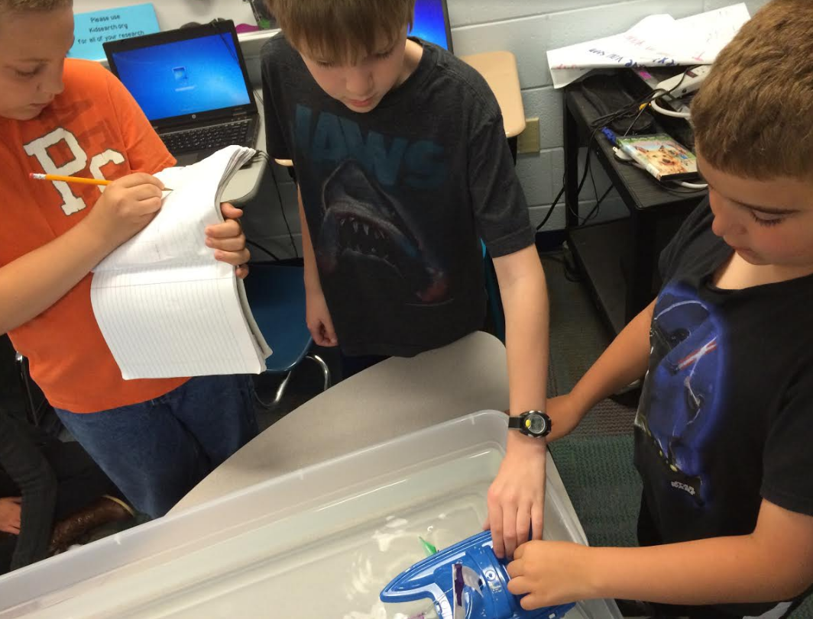
HOW SLOW CAN YOU GO
MAKING STEM CONNECTIONS TO BUILD STUDENTS’ UNDERSTANDING OF FORCE AND DRAG
ARIELLE MUCHA
JAMES MINOGUE
KLONDIKE ELEMENTARY
This material is based upon work supported by the National Science Foundation under Grant No. 0962840
.

Slide 2
SLOW BOAT
4.PS.1 PHYSICAL SCIENCE
LIFT
FORCES
DRAG
FRICTION
THRUST
3-5 ENGINEERING
3-5.E.1
IDENTIFY A PROBLEM, INCLUDE CRITERIA AND CONSTRAINTS
3-5.E.2
COMPARE MULTIPLE SOLUTIONS BASED ON CRITERIA AND CONSTRAINTS
3-5.E.3
USE RESULTS FROM FAIR TESTS TO IMPROVE MODEL/PROTOTYPE

Slide 3
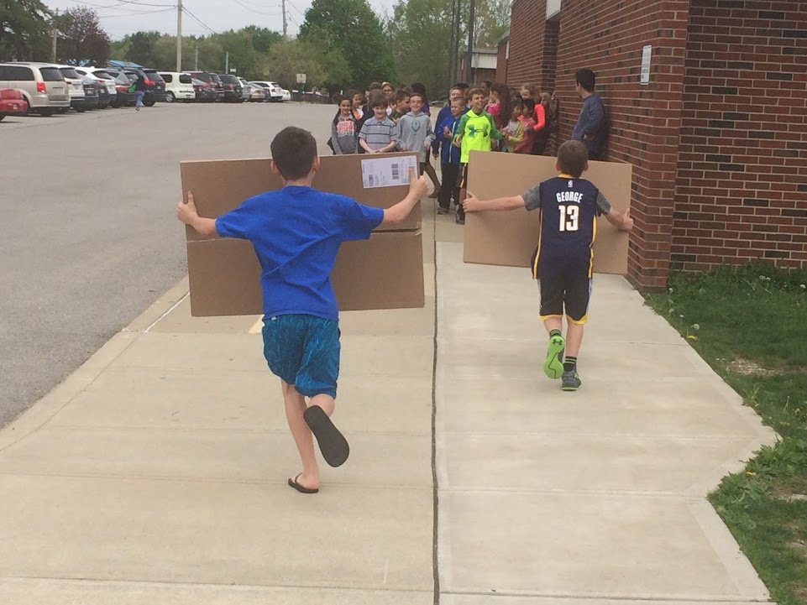
SLOW BOAT -INQUIRY
INQUIRY ACTIVITIES
HOLLOW BALL
FEEL THE “FORCE”
SPEED TRIALS
WATER VS. AIR

Slide 4
WHAT IS DRAG

Slide 5
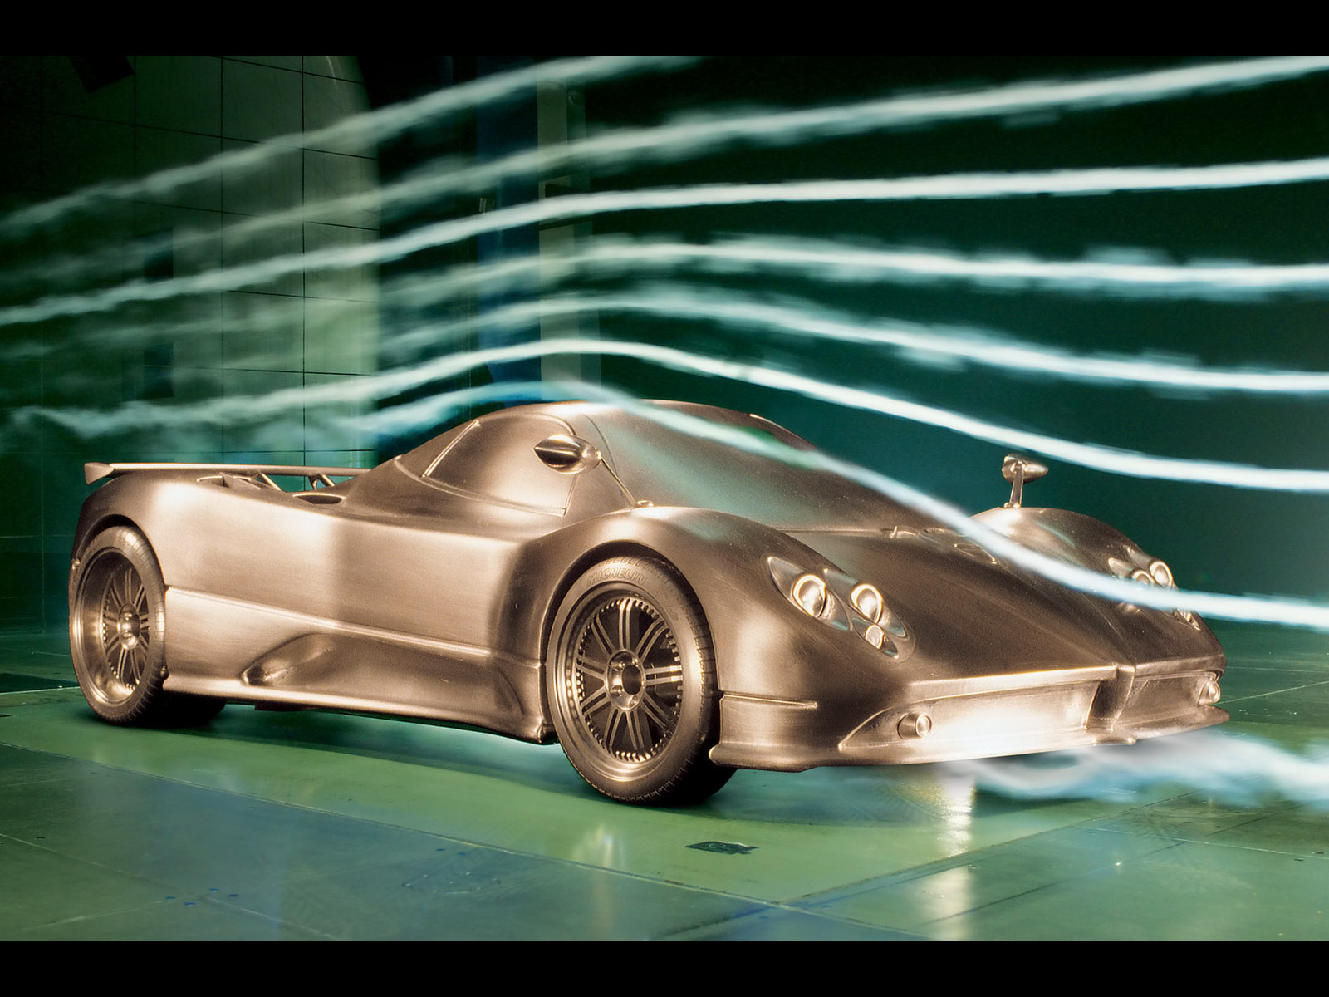
LOW, MEDIUM AND HIGH DRAG

Slide 6
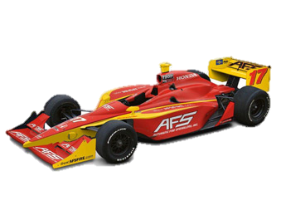
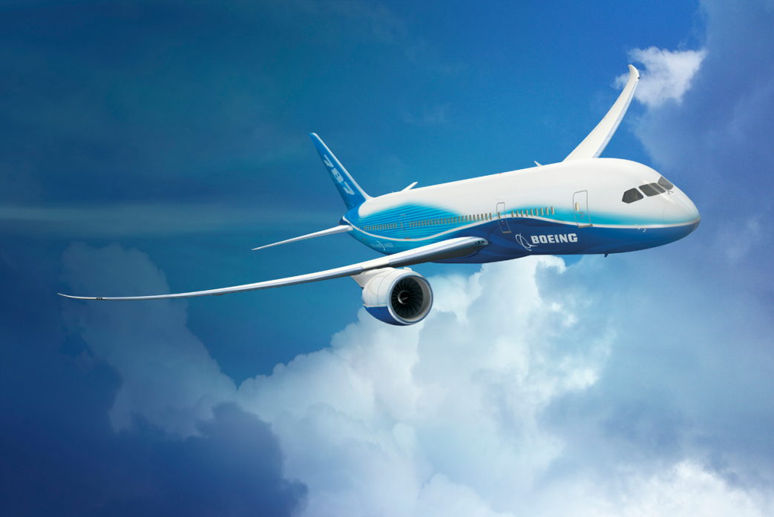
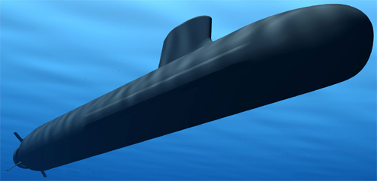
LOW DRAG (EASILY MOVES THROUGH AIR AND WATER)

Slide 7
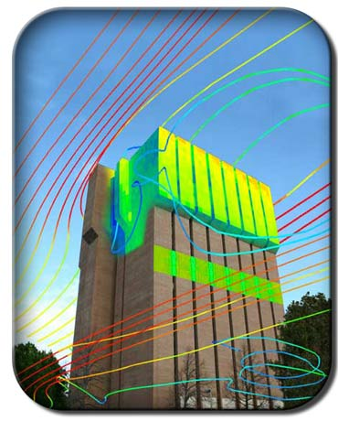
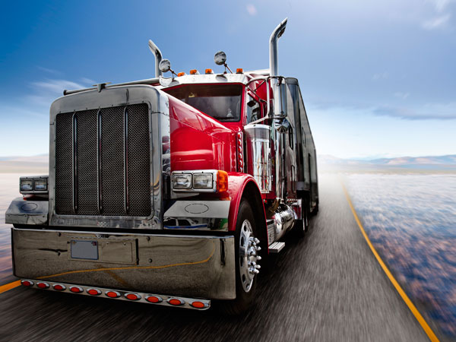
MEDIUM DRAG

Slide 8
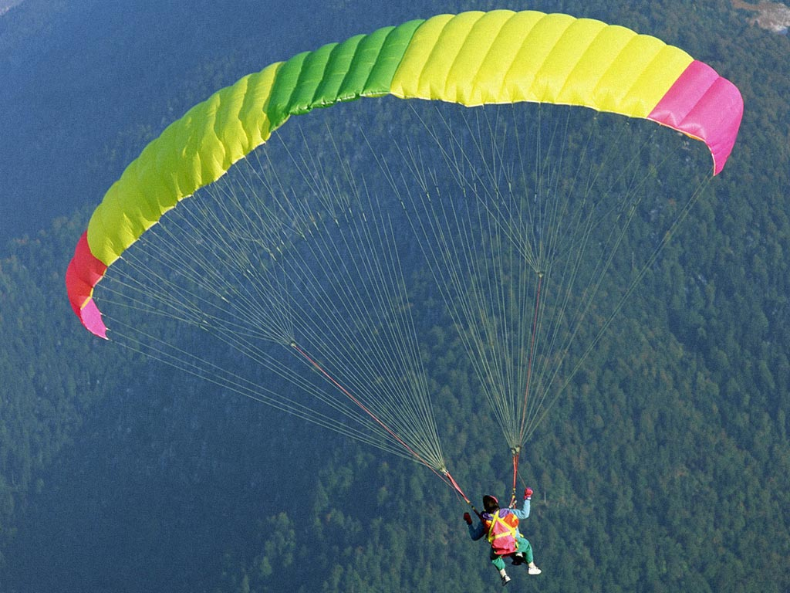
HIGH DRAG – USUALLY MADE WITH THE PURPOSE OF MOVING SLOWER THROUGH AIR OR WATER

Slide 9
DRAG CONCAVE VS. CONVEX SHAPES
Convex
Look at the lines that represent how air or fluid flows over the different shapes.
Which shape allows the most air or liquid to flow over it? This one has LOW drag. There is little force acting on this shape which is why it flows easily over it.
Which shape allows the least amount of air or liquid to flow over or past it? This one has HIGH drag. There is a lot more force acting on this shape and has a hard time flowing over the object.
1
2
Low
Drag
3
4
Concave
1
2
3
High
Drag
4
5
6

Slide 10
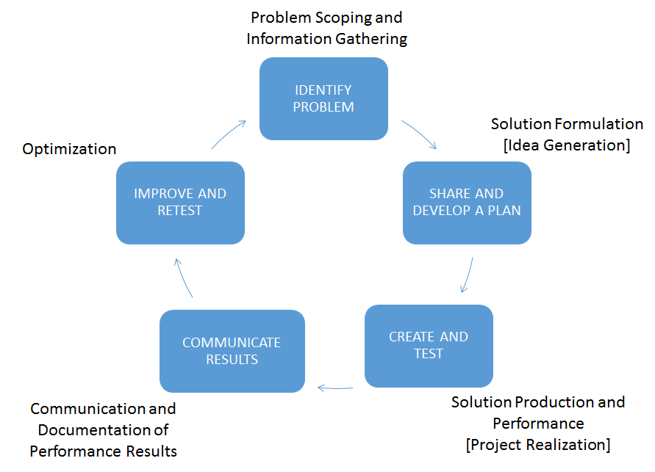
THE ENGINEERING DESIGN PROCESS

Slide 11
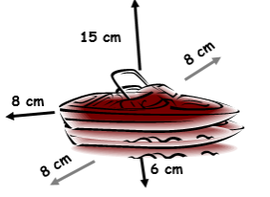
SLOW BOAT – DESIGN TASK
TWO FOURTH GRADERS WENT FISHING IN A SMALL BOAT. ONE OF THEM HOOKED A FISH THAT WAS SO BIG IT PULLED THE BOAT THROUGH THE WATER. THIS MADE IT REALLY HARD TO REEL IN THE FISH. THE FOURTH GRADERS DECIDED THEY NEEDED TO FIND A WAY TO SLOW DOWN THE BOAT THE NEXT TIME THEY WENT FISHING SO THEY DID NOT HAVE THE SAME PROBLEM.
THEY GOT A BOX FULL OF PARTS FROM THEIR HOMES AND SAT DOWN TO DESIGN A WAY TO SLOW THE BOAT DOWN.
CAN YOU HELP THEM DESIGN A BOAT THAT MOVES SLOWLY THROUGH THE WATER? YOU WILL BE PROVIDED A PLASTIC BOAT TO USE AS A PROTOTYPE THAT YOU CAN MODIFY TO MAKE IT MOVE SLOWLY THROUGH THE WATER.
Materials
Plastic Plates
Craft sticks
Spoons
Small plastic cup
Foam
Rubber bands
Duct tape
String
*Should not touch bottom of pond/water tub
Criteria (features)
Should slow the boat
Boat should still float
Constraints Limitations
Cannot touch the bottom of the container
Dimensions
Materials (Cost & Budget)
Time

Slide 12
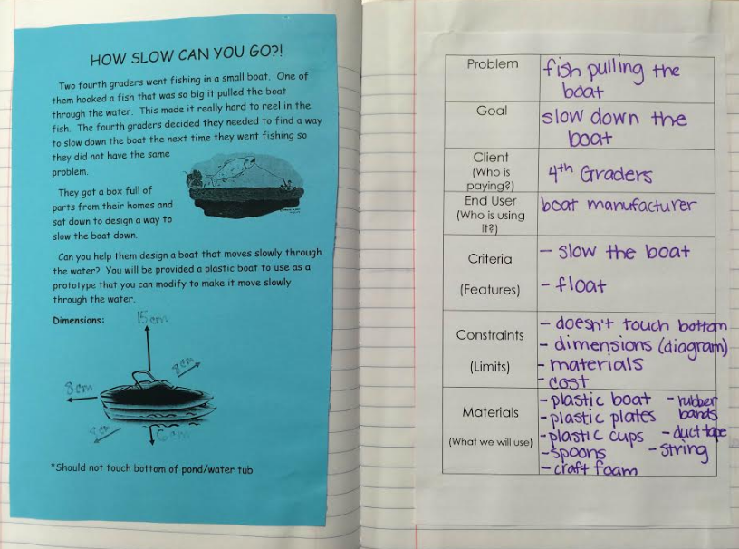
DESIGN BRIEF TEMPLATE – SLOW BOAT

Slide 13
THE ENGINEERING DESIGN PROCESS

Slide 14
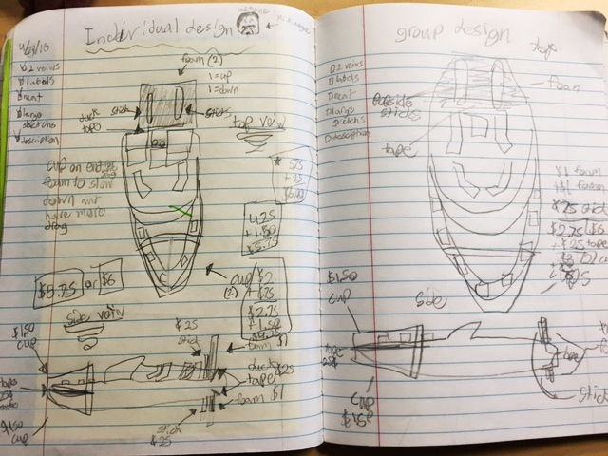
GROUP/INDIVIDUAL DESIGN - EXAMPLES

Slide 15
MATERIALS AND COST
Craft sticks - $0.25/each
Spoons - $0.25/each
Plastic Plate - $1.00
Small plastic cup - $1.50
Foam - $1.00
Rubber bands – $0.25/each
Duct tape (2 foot strip) - $0.25
String - Free
BUDGET = $6.00

Slide 16
YOUR TURN! - INDIVIDUAL DESIGN
REMEMBER…
Makes good use of space
Labels/key
Multiple views
Key science content terms
Materials
Plastic Plates
Craft sticks
Spoons
Small plastic cup
Foam
Rubber bands
Duct tape
String
You have 5 minutes!

Slide 17
THE ENGINEERING DESIGN PROCESS

Slide 18
YOUR TURN! - GROUP DESIGN
REMEMBER…
Groups of 2/3
Everyone shares ideas/design sketches
Group consensus
Each person sketches group design in individual notebooks.
You have 10 minutes!

Slide 19
THE ENGINEERING DESIGN PROCESS

Slide 20
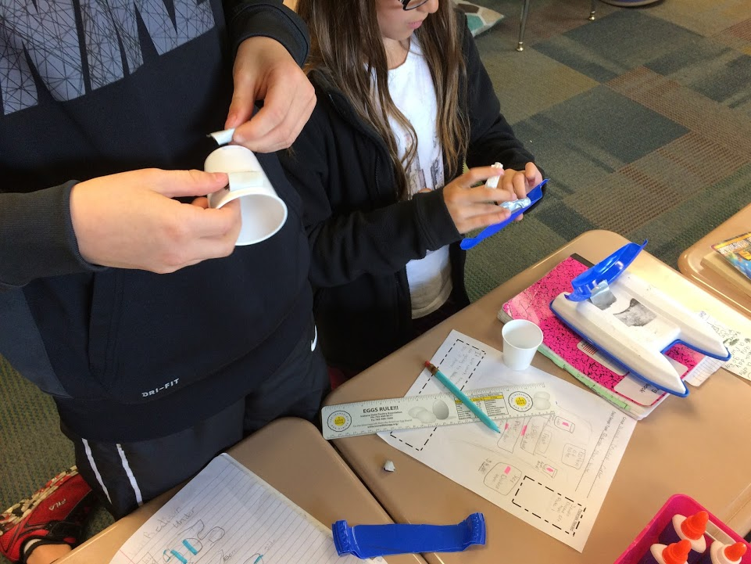
YOUR TURN! - GROUP BUILD/TEST!
REMEMBER…
Try to stick to your group design!
If you adjust record it on your design sketch!
Test you design and see if it meets the criteria!
Was your team successful?
You have 15 minutes!

Slide 21
THE ENGINEERING DESIGN PROCESS

Slide 22
COMMUNICATE RESULTS
2017 4th Grade Slowest Slow Boat Trials
Boat | Total Cost ($) | Trial 1 (s) | Trial 2 (s) | Trial 3 (s) | Average Time | Met Criteria
1 | 5.00 | 4.7 | 4.9 | 5.0 | 4.85 | Yes
2 | 5.50 | 4.3 | 4.5 | 4.3 | 4.35 | Yes
3 | 4.50 | 8.5 | 8.6 | 7.9 | 8.33 | Yes
4 | 5.00 | 4.3 | 5.0 | 4.2 | 4.50 | Yes
5 | 5.50 | 5.0 | 5.1 | 5.3 | 5.13 | Yes
6 | 3.50 | 4.9 | 5.0 | 4.8 | 4.90 | Yes
7 | 5.25 | 4.5 | 4.6 | 5.0 | 4.7 | Yes
8 | 3.25 | 5.4 | 4.1 | 5.5 | 5.0 | Yes/No
9 | 4.25 | 3.2 | 3.4 | 3.4 | 3.33 | Yes

Slide 23
COMMUNICATE RESULTS
Did your boat meet the requirements?
In what ways did your team use what you know about drag forces to inform your design?
What did the boats that moved the slowest have in common?
What ideas did you see on other boats that you might want to utilize in your next design?

Slide 24
THE ENGINEERING DESIGN PROCESS

Slide 25
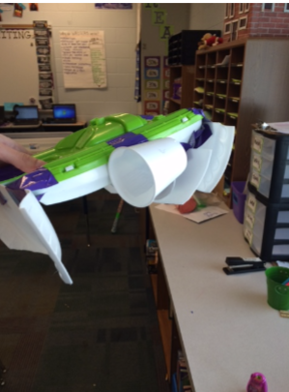
IMPROVE AND RETEST
INDIVIDUAL AND/OR GROUP REDESIGN
GROUP REBUILD AND TESTING.
REFLECTION
NOTE IMPROVEMENTS
STRENGTHS/WEAKNESSES
ADDITIONAL REDESIGN
REFLECTION ON WHOLE EXPERIENCE

Slide 26
YOUR TURN! - REDESIGN/TEST!
REMEMBER…
In what ways could you improve your design?
What is one feature you could re-design?
Sketch out your redesign with your team and then build it.
Come up to retest it when your team is ready!
You have 15 minutes!

Slide 27
COMMUNICATE RESULTS
2017 4th Grade REDESIGN Slowest Slow Boat Trials
Boat | Total Cost ($) | Trial 1 (s) | Trial 2 (s) | Trial 3 (s) | Average Time | Met Criteria | How much slower?
1 | 4.25 | 4.2 | 4.3 | 4.2 | 4.23 | Yes | +.6
2 | 5.25 | 7.4 | 7.5 | 7.2 | 7.36 | Yes | 3.01
3 | 5.50 | 11.1 | 11.3 | 11.6 | 11.33 | Yes | 3.0
4 | 5.50 | 4.6 | 5.4 | 5.1 | 5.03 | Yes | .53
5 | 6.00 | 6.9 | 7.4 | 6.9 | 7.06 | Yes | 1.93
6 | 4.50 | 5.0 | 5.2 | 5.3 | 5.16 | Yes | .26
7 | 4.25 | 5.0 | 5.2 | 5.0 | 5.06 | Yes | .36
8 | 4.50 | 7.6 | 7.4 | 8.4 | 7.8 | Yes | 2.8
9 | 4.75 | 5.6 | 6.0 | 6.4 | 6.00 | Yes | 2.68

Slide 28
Evidence of student learning
DESIGN NOTEBOOK ENTRIES
STUDENT USE OF SCIENCE CONTENT VOCABULARY (WHEN WORKING WITH TEAM OR COMMUNICATING RESULTS)
PRE/POST ASSESSMENT RESULTS (SLED)
SELF/TEAM RUBRIC
Short video clip of a student talking aloud about their ideas

Slide 29
Questions
JAMES MINOGUE
KLONDIKE ELEMENTARY
JJMINOGUE@TSC.K12.IN.US
ARIELLE MUCHA
KLONDIKE ELEMENTARY
ASMUCHA@TSC.K12.IN.US
To learn more about the SLED Partnership, please go to our link at sledhub.org

