Slide 1
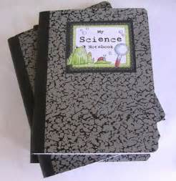
Graphic Organizers with Science Notebooking
Nikki Rumpler
Stacy VanDerWeele

Slide 2
How We Use the Notebook
*Our students put EVERYTHING in the notebook.
*Table of Contents and page numbering
*Vocabulary
*Notes
*Drawings, Charts, Tables, etc.
*Investigations and Design Challenges
*Answers to questions from readings
*Foldables

Slide 3
Getting Started
*It’s all about ORGANIZATION
*Table of Contents- various ways to do this
*Number all pages
*Options for having a Glossary at the end
*Constantly remind students to update their table of contents as the year goes on.

Slide 4
Science Notebook
*Can divide the notebook with “Title” pages between each topic or unit of study.
*Can use tabs to break notebook into sections based on topics or different units of study.
*Make sure to “Title” each page- this helps students know what to write in the table of contents
*THINK DIFFERENTLY: You can glue anything into the notebook! OR… have the kids write all the steps, etc. directly into the notebook.

Slide 5
Ways to Include things in notebook
*Shrink “worksheets” and papers down so that they will easily fit into the notebook.
*Type up (and shrink) any questions they need to answer, so that they can be glued in the notebook. Their answers can be written directly into the notebook.
*Glue worksheets and/or papers directly into the notebooks….examples
*Make pockets to hold papers: EXAMPLES

Slide 6
Foldables
*This is one of our favorites!
*Great ways to organize vocabulary and so many different things.
*Examples: 5th & 6th grade topics
Resources:
Dinah Zike’s Notebook Foldables For Spirals, Binders, & Composition Books 4th Grade to College
Dinah Zike’s Big Book of Science

Slide 7
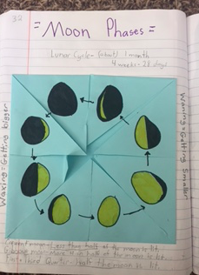
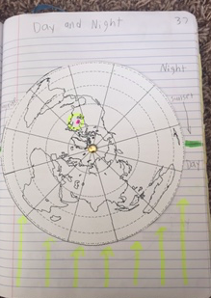
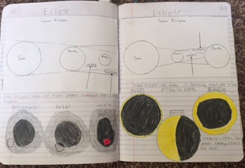
Examples:

Slide 8
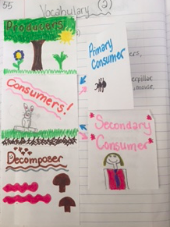
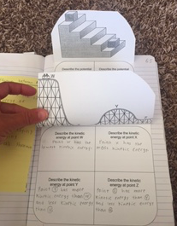
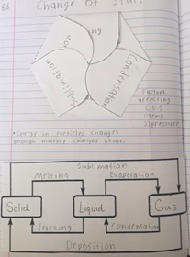
Examples:

Slide 9
RESOURCES:
Using Science Notebooks in Elementary Classroom Michael P. Klentschy (NSTA press)
Dinah Zike’s Big Book of Science Elementary K-6
Dinah Zike’s Notebook Foldables For Spirals, Binders, & Composition Books 4th Grade-College
PINTEREST: Lots of examples and ways to integrate foldables, graphic organizers, and notebooking

Slide 10
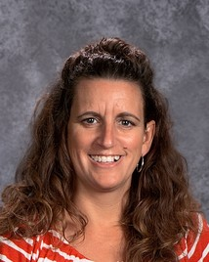
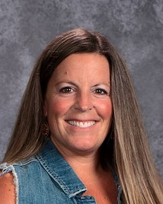
Contact Info:
Nikki Rumpler
nrumpler@plymouth.k12.in.us
Stacy VanDerWeele
svanderweele@plymouth.k12.in.us

