Slide 1
How am I supposed to grade this?
Get all of the presentation here:
https://sites.google.com/tsc.k12.in.us/assessdesign/home
Colleen Cooper & Aaron Hamilton
Wyandotte Elementary

Slide 2
By the end of this session, teachers will be able to...
Identify multiple ways of assessing student learning both formatively and summatively throughout a design experience
Generate one or more purposeful ways to evaluate student learning of science through engineering design
Make connections between today’s design experiences and grade appropriate forms of assessment

Slide 3
Take a look back
Discuss with your table what you could have assessed during your morning design activity.

Slide 4
Our Typical Science Unit
This is our consistent approach to each unit to increase mastery of the needed science concepts.
5 days of pre-teaching
-Some textbook reading
-Videos
-Inquiry activity
*All focused to get background knowledge of the science concepts needed for design
5-6 days of design
1. Introduce problem &
2. Individual design
3. Team design
4. Build
5. Present & Test
6. Wrap-up & Redesign

Slide 5
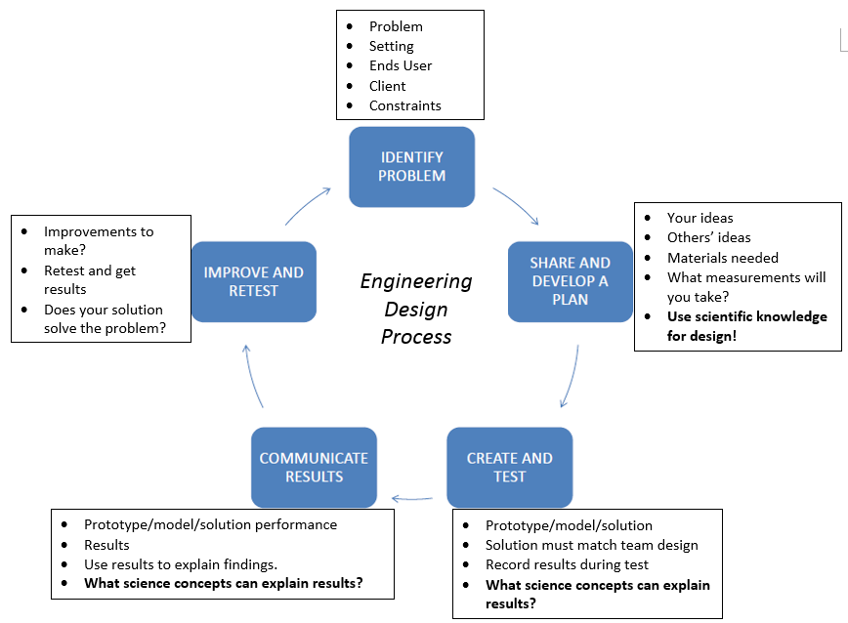

Slide 6
Questions to Consider
What should we assess about children’s science learning? What do we value?
How should we assess children’s science learning?
When should we assess children’s science learning?

Slide 7
Assessment vs Grading
Assessment drives student learning and provides feedback for both students and the teacher
*Determine what they have or have not learned (knowledge-based)
*Determine what they can or cannot do (performance-based)
*Determine how we will teach (instruction-based)

Slide 8
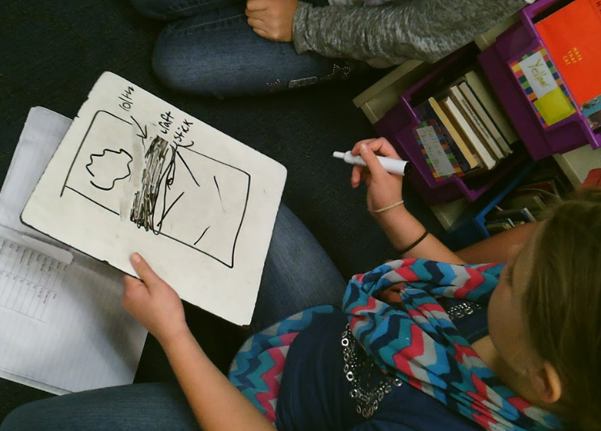
3 Types of Assessment in Engineering Design
Hearing students’ thoughts and ideas
Seeing what students have done
Observing how students use evidence to provide an explanation
*Assessment is standards-based
“Assessment--not grading--is the heart of instruction.” (Beers & Probst, Notice and Note)

Slide 9
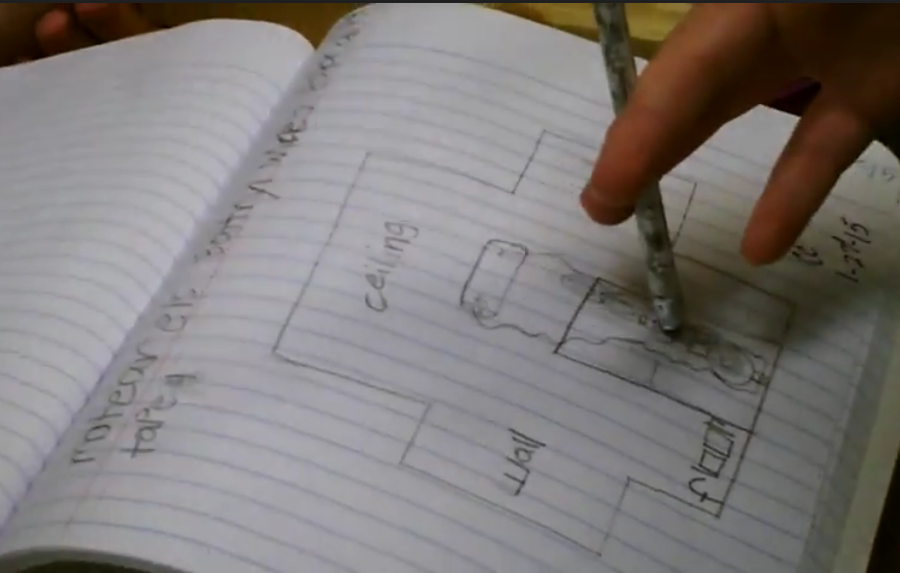
Hearing their thoughts
-Before building a prototype (individual and team designs)
-While building a prototype (group chatter)
-Planning to present the prototype (written paragraph and discussion as a group)
-During presentation of prototype (students present their prototype and use science concepts to explain how it works)
How to assess it:
-Clipboard of groups 1-5 scale
-Videotaping
-Debrief as a class

Slide 11
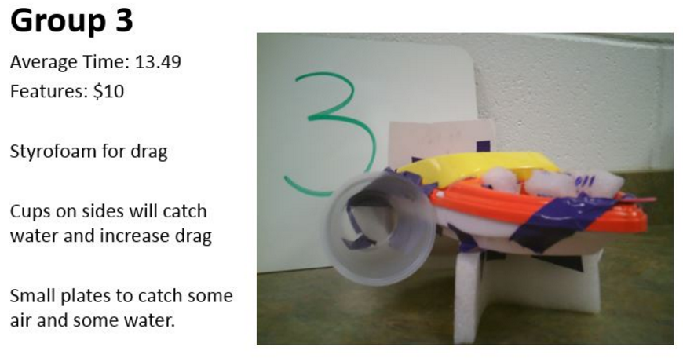
Seeing what they do
-Design notebook (inquiry, conclusions, individual & team design, ideas)
-The prototype performance
*Failure of a prototype does not mean failure in understanding*
-Activity wrap-up
-Redesign
How to assess it
-Walk around the class and observe
-Collect the design notebooks at the end of the unit and use a rubric
-Seek feedback from a consultant (5th/6th?)

Slide 12
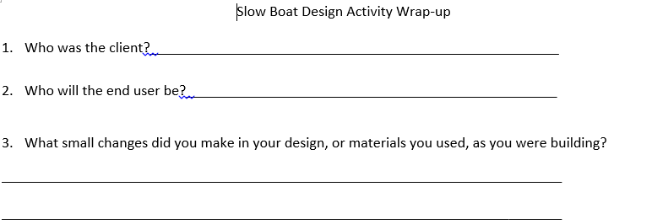
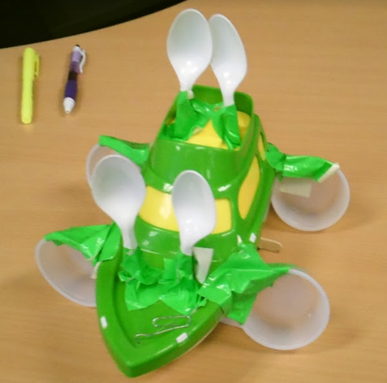
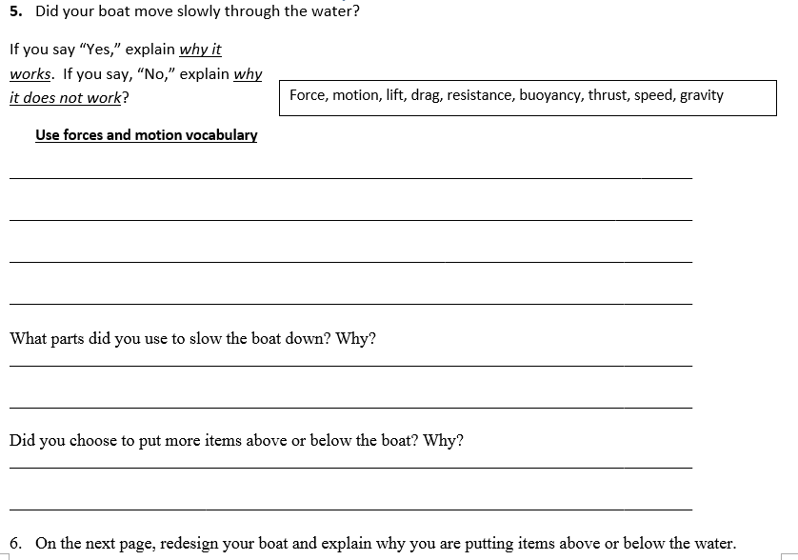
Wrap-Up Example- Use Evidence to Provide Explanation

Slide 13
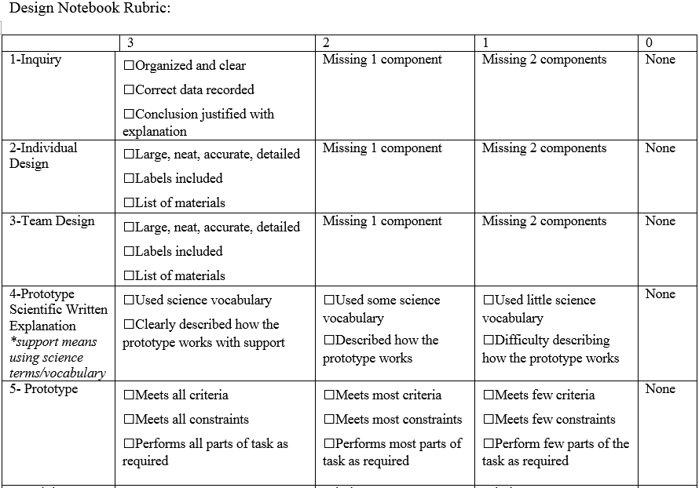
Rubric Example
Criteria is the left column
3, 2, 1, 0 are levels of performance

Slide 14
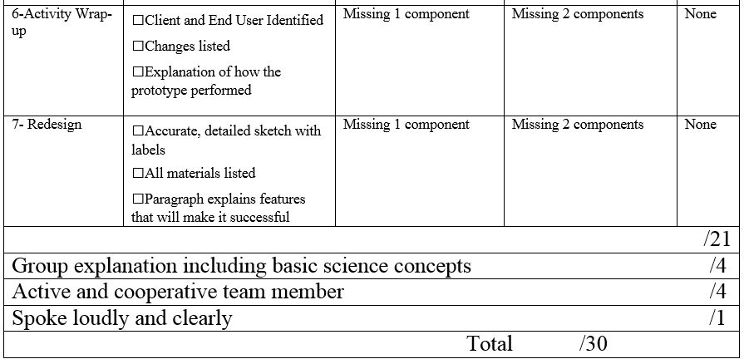
Rubric example continued

Slide 15
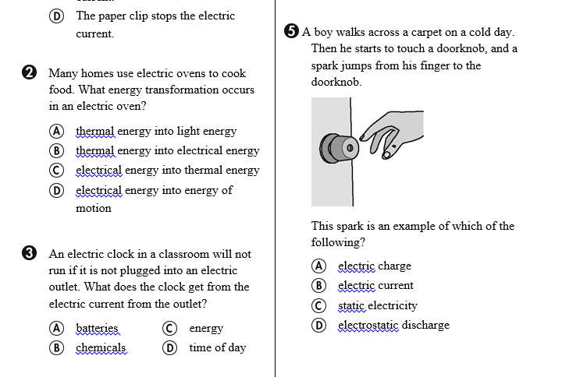
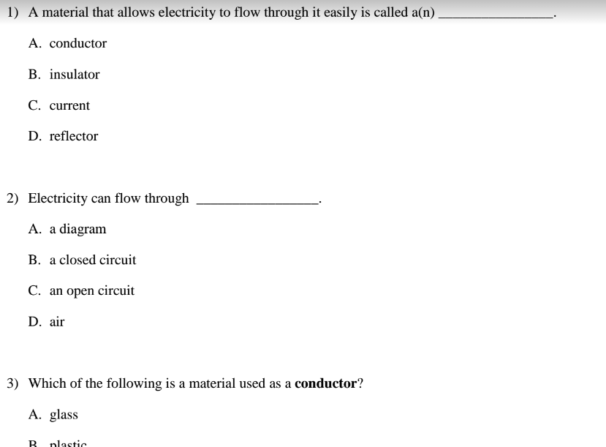
Standards-based assessments
Pre/post tests (3rd and up)

Slide 16
Take a look at a notebook
What challenges did you see potentially existing while grading?
What did you look for while grading?

Slide 17
Other additions in the classroom
Bring in technology
Present in a variety of ways
Discuss and share information in a variety of ways

Slide 18
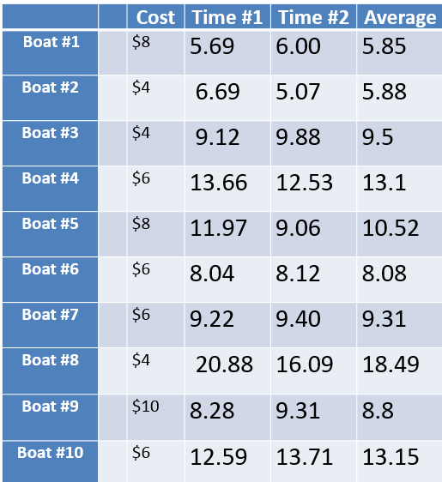
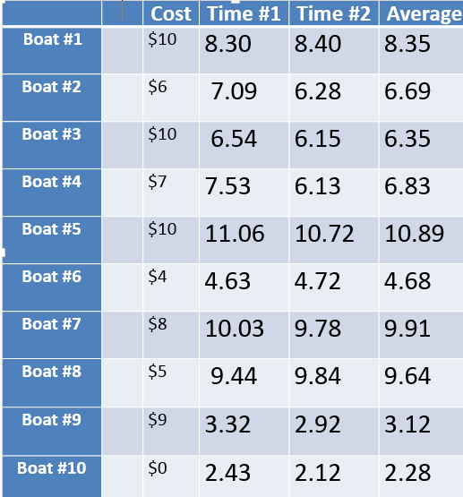

Slide 19
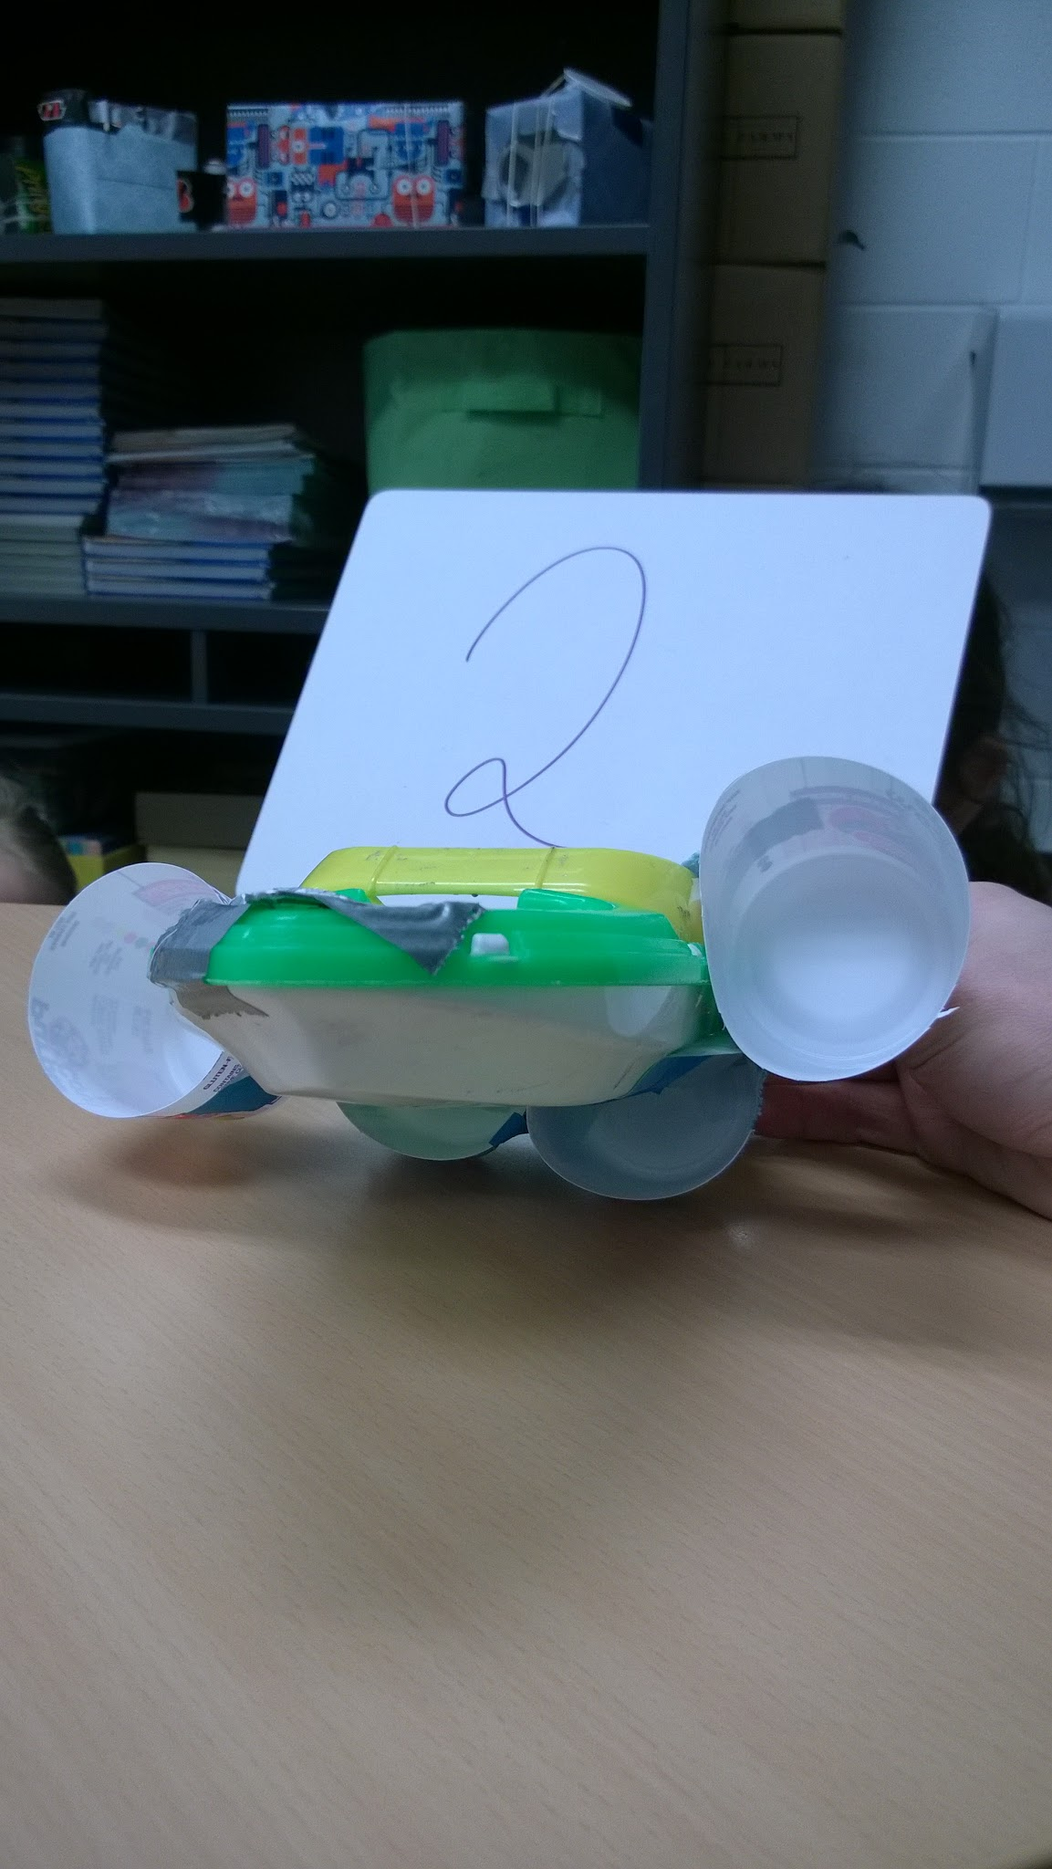
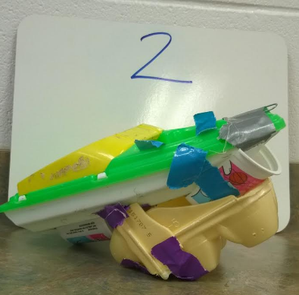
By Group # 2
Features: Yogurt cup,Duck Tape.The yogurt cups on the sides are there because when the boat starts they will fill up with water and slow the boat down. The cups on the bottom are there because they can catch more water.the end

Slide 20
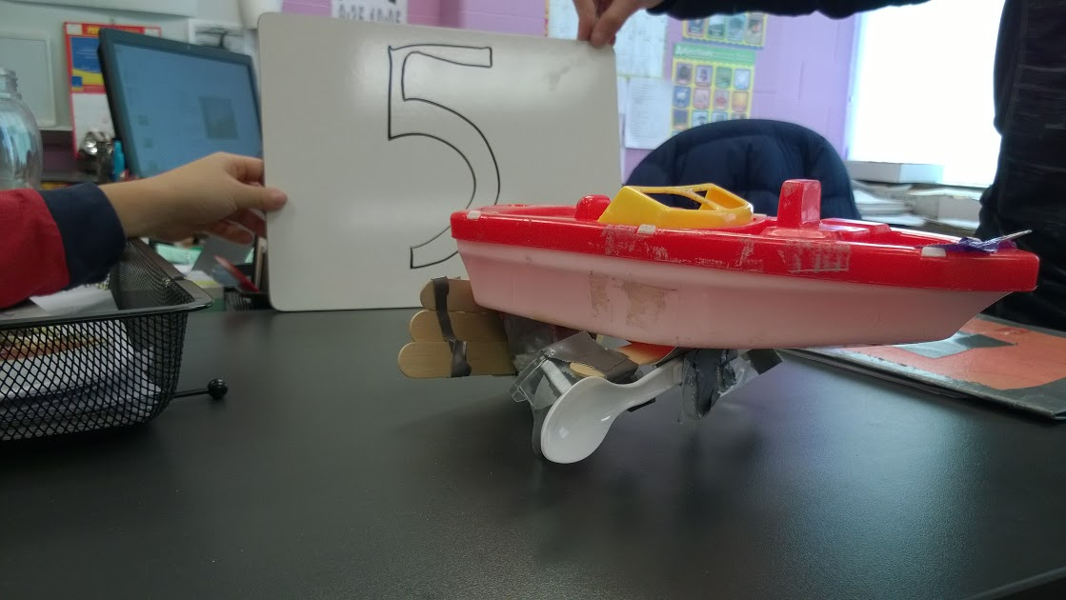
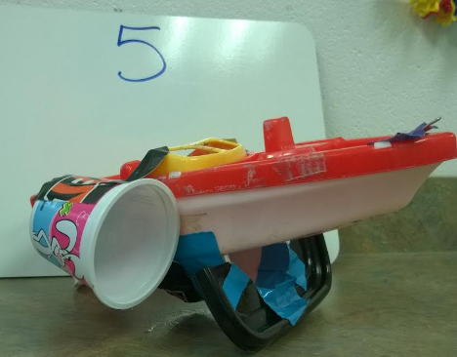
Group #5
Features:the spoons stop the water from escaping from the sides.
The small cup stops the water from running freely.
The popsicle sticks stop more water from coming through.

Slide 21
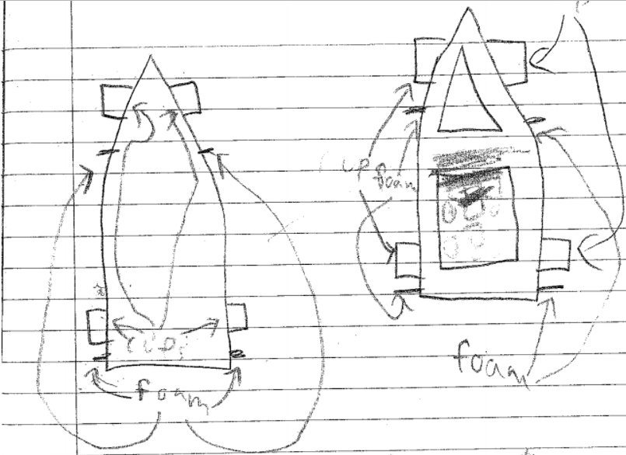
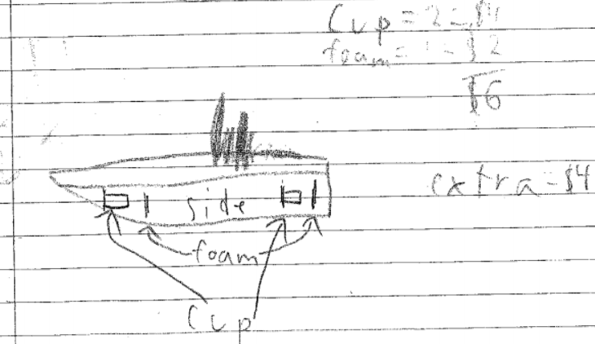
Team Design

Slide 22
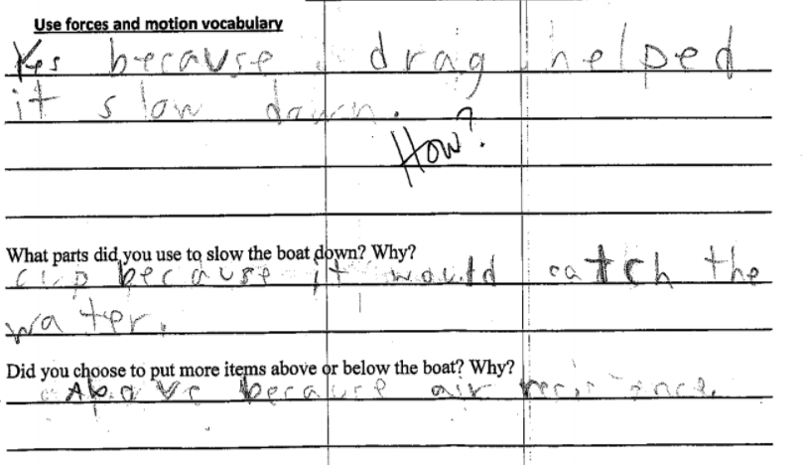
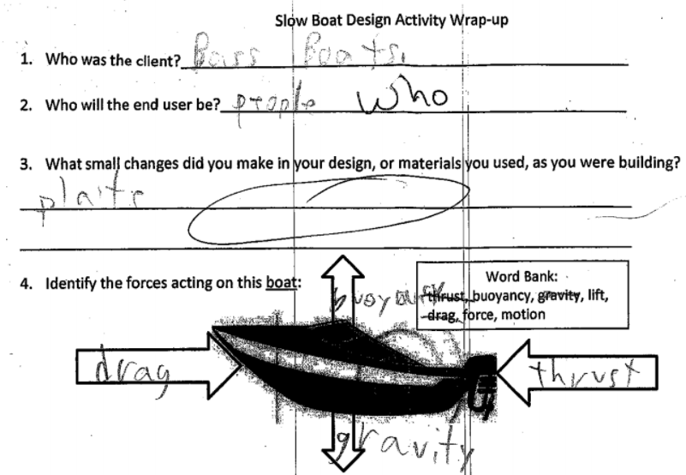
Wrap-up

Slide 23
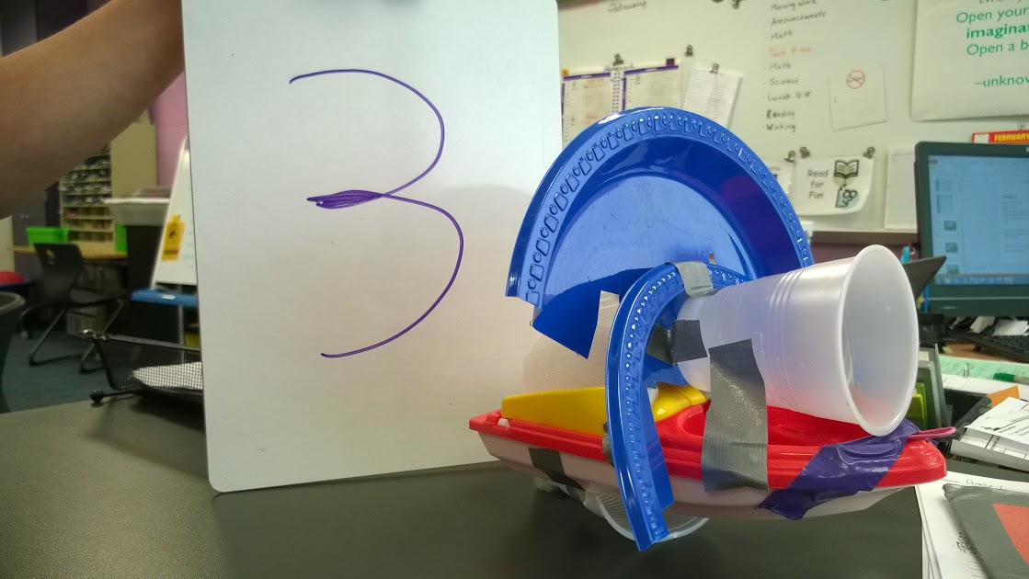
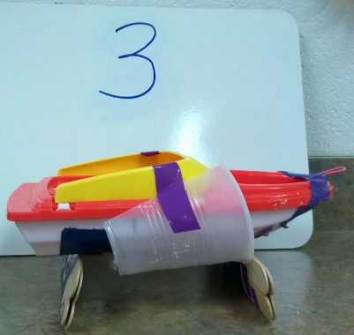
Group #3
Features: air resistance, water resistance, shade,foam.

Slide 24
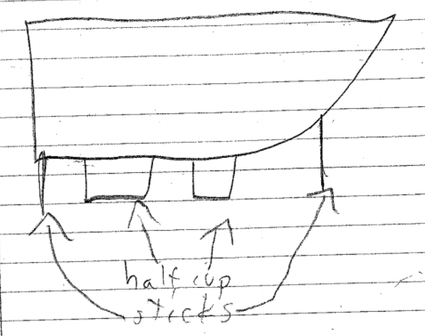
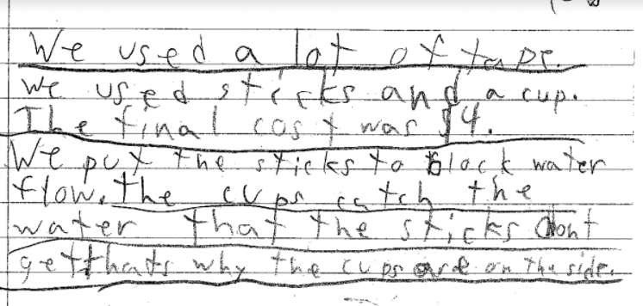
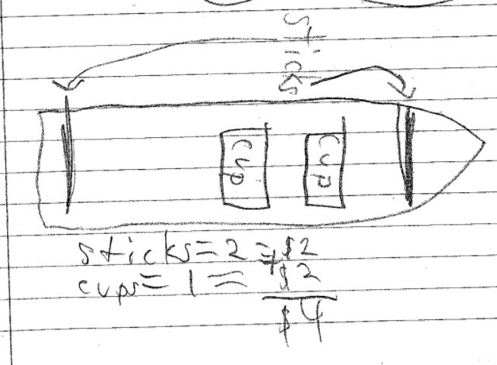
Redesign

Slide 25
More than just a notebook for a grade
You get a lot of valuable data from the notebook, but you should also prompt students for more at a variety of points to scaffold. You will see more understanding from students when seeing/hearing their thought processes!

Slide 26
Get all of the presentation here
https://sites.google.com/tsc.k12.in.us/assessdesign/home

